Slide 1
Chapter 10 Two-Sample Hypothesis Tests
Copyright © 2022 McGraw Hill. All rights reserved. No reproduction or distribution without the prior written consent of McGraw Hill.
1-1

Slide 2
Chapter Learning Objectives
Chapter 10
LO10-1: Recognize and perform a test for two means.
LO10-2: Explain the assumptions underlying the two-sample test of means.
LO10-3: Construct a confidence interval for µ₁ − µ₂.
LO10-4: Recognize paired data and be able to perform a paired t test.
LO10-5: Perform a test to compare two proportions using z.
LO10-6: Check whether normality may be assumed for two proportions.
LO10-7: Construct a confidence interval for π₁− π₂.
LO10-8: Carry out a test of two variances using the F distribution.

Slide 3
Two-Sample Tests
Chapter 10
Two-sample tests compare two sample estimates with each other.
one-sample tests compare a sample estimate with a nonsample benchmark or target
Two-sample tests are especially useful because they possess a built-in point of comparison.
Before versus after
Old versus new
Experimental versus control

Slide 4
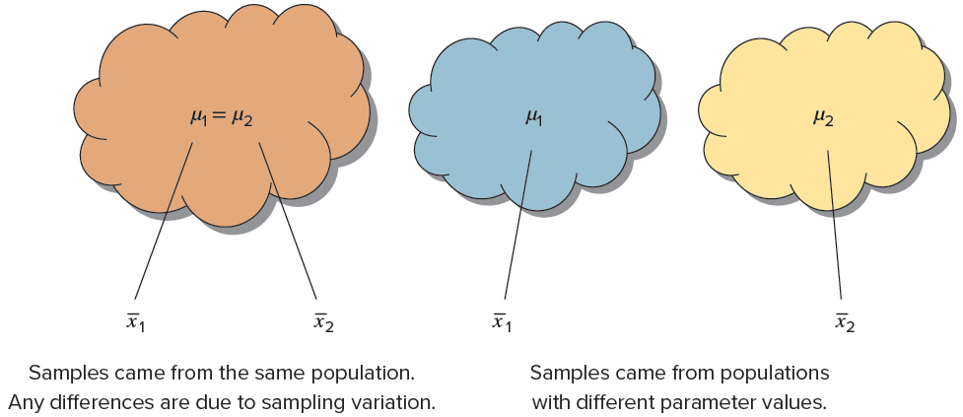
Two-Sample Tests
Chapter 10
The logic of two-sample tests is based on the fact that two samples drawn from the same population may yield different estimates of a parameter due to chance.
If two sample statistics differ by more than the amount attributable to chance can we conclude that the samples came from populations with different parameter values.

Slide 5
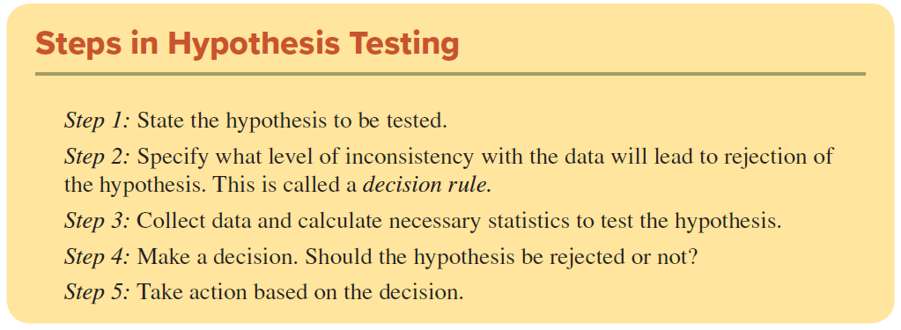
Two-Sample Tests
Chapter 10
We follow the same steps as we did with one-sample tests of hypothesis.

Slide 6

Format of Hypothesis
LO 10-1
The process of comparing two means starts by stating null and alternative hypotheses. The hypotheses for comparing two independent population means µ₁ and µ₂ are:
D₀ is the hypothesized difference.

Slide 7
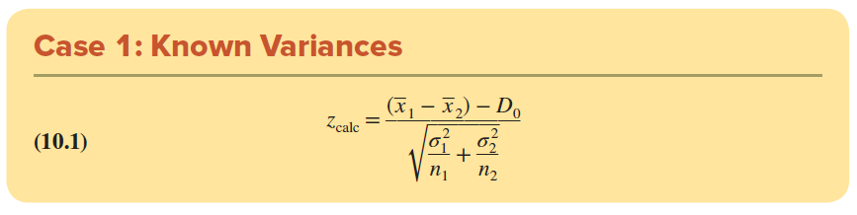

Test Statistic
LO 10-1
Known Variances
For the case where we know the values of the population variances, ${\text{σ}}_{1}^{2}$ and ${\text{σ}}_{2}^{2}$, the test statistic is a z-score.

Slide 8
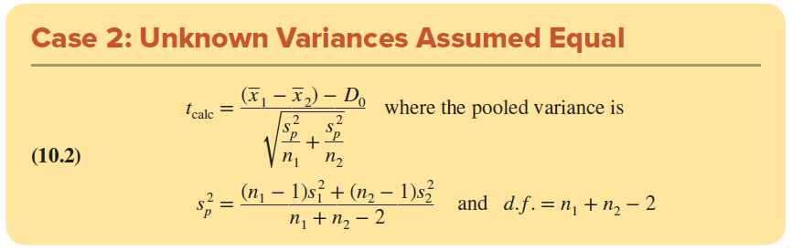

Test Statistic
LO 10-1
UnKnown Variances, Assumed Equal
Since the variances are unknown, they must be estimated and the Student’s t distribution is used to test the means.
Assuming the population variances are equal, ${\text{s}}_{1}^{2}$ and ${\text{s}}_{2}^{2}$ can be used to estimate a common pooled variance, s_{p}².

Slide 9
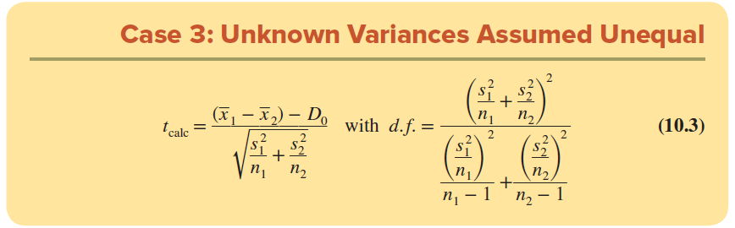

Test Statistic
LO 10-1
UnKnown Variances, Assumed Unequal
If the unknown variances ${\text{σ}}_{1}^{2}$ and ${\text{σ}}_{2}^{2}$ are assumed unequal, we do not pool the variances.
Finding degrees of freedom requires a tedious calculation, but this is easily handled by Excel.

Slide 10
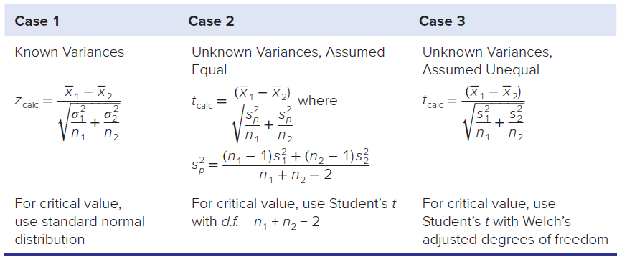

Summary of the Test Statistic
LO 10-1
If the population variances ${\text{σ}}_{1}^{2}$ and ${\text{σ}}_{2}^{2}$ are known, then use the normal distribution, Z.
If population variances are unknown and estimated using ${\text{s}}_{1}^{2}$ and ${\text{s}}_{2}^{2}$, then use the Students t distribution.

Slide 11
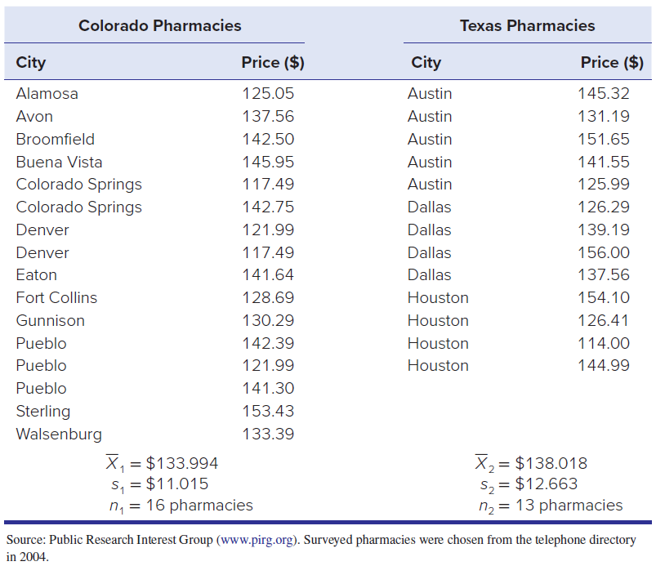
Example: Drug Prices in Two States
LO 10-1
The price of prescription drugs is an ongoing national issue in the United States. Zocor is a common prescription cholesterol-reducing drug prescribed for people who are at risk for heart disease. The table shows Zocor prices (30 day supply) from randomly selected pharmacies in two states.
At α = .05, is there a difference in the mean for all pharmacies in Colorado and Texas?

Slide 12

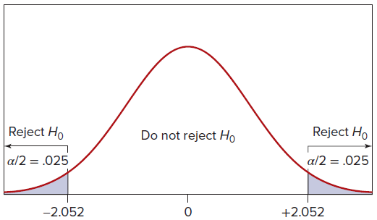
Example: Drug Prices in Two States
LO 10-1
Step 1: State the Hypotheses
To check for a significant difference (D0 = 0) without regard for its direction, we choose a two-tailed test. The hypotheses to be tested are
Step 2: Specify the Decision Rule
We will assume equal variances. For the pooled-variance t test, degrees of freedom are d.f. = n1 + n2 − 2 = 16 + 13 − 2 = 27.
We get the two-tail critical value t = ±2.052.

Slide 13
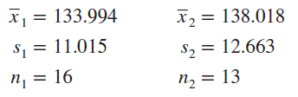
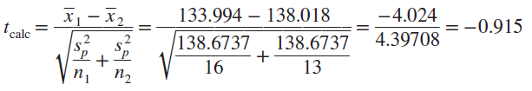

Example: Drug Prices in Two States
LO 10-1
Step 3: Calculate the Test Statistic
The sample statistics are:
Because we are assuming equal variances, we use the formulas for Case 2. The pooled variance ${\text{s}}_{p}^{2}$ is
Using ${\text{s}}_{p}^{2}$, the test statistic is

Slide 14
Example: Drug Prices in Two States
LO 10-1
Step 4: Make the Decision
The test statistic t_{calc} = −0.915 does not fall in the rejection region, so we cannot reject the hypothesis of equal means.
Step 5: Take Action
Because the difference in sample means is within the realm of chance assuming that H0 is true, no further investigation is required.
Test Statistic: t = -0.915
Fail to Reject H₀

Slide 15
Example: Drug Prices in Two States
LO 10-1
P-Value Approach
The p-value can be verified using the two-tailed Excel function =T.DIST.2T(.915,27) = .3681. This large p-value (greater than α = .05) says that a difference of sample means of this magnitude would happen by chance about 37 percent of the time if μ1 = μ2. The observed difference in sample means seems to be well within the realm of chance.

Slide 16
Underlying Assumptions
LO 10-2
Which Unknown Variance test is best?
If the sample sizes are equal, the test statistics for the Pooled Test and the Unequal Test will be identical, although the degrees of freedom may differ.
If the variances are similar, the two tests will usually agree.
If no information about the population variances is available, then the best choice is the Unequal Test.
The fewer assumptions, the better.
Must sample sizes be equal?
No, unequal sample sizes are common and the formulas still apply.

Slide 17
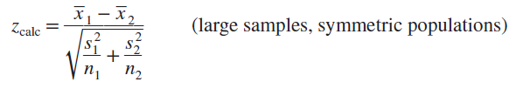
Underlying Assumptions
LO 10-2
What about large samples?
For unknown variances, if both samples are large (n₁ ≥ 30 and n₂ ≥ 30) and you have reason to think the population isn’t badly skewed (look at the histograms or dot plots of the samples), it is common to use Z test. Although it usually gives results very close to the “proper” t tests, this approach is not conservative (i.e., it may increase Type I risk).

Slide 18
Caution: Three Issues
LO 10-2
Bear in mind three questions when you are comparing two sample means:
Are the populations skewed? Are there outliers?
Check using histograms and/or dot plots of each sample. t tests are okay if moderately skewed, especially if samples are large. Outliers are more serious.
Are the sample sizes large (n ≥ 30)?
If the samples are small, the mean is not a reliable indicator of central tendency, and the test may lack power.
Is the difference important as well as significant?
A small difference in means or proportions could be significant if the sample size is large.

Slide 19
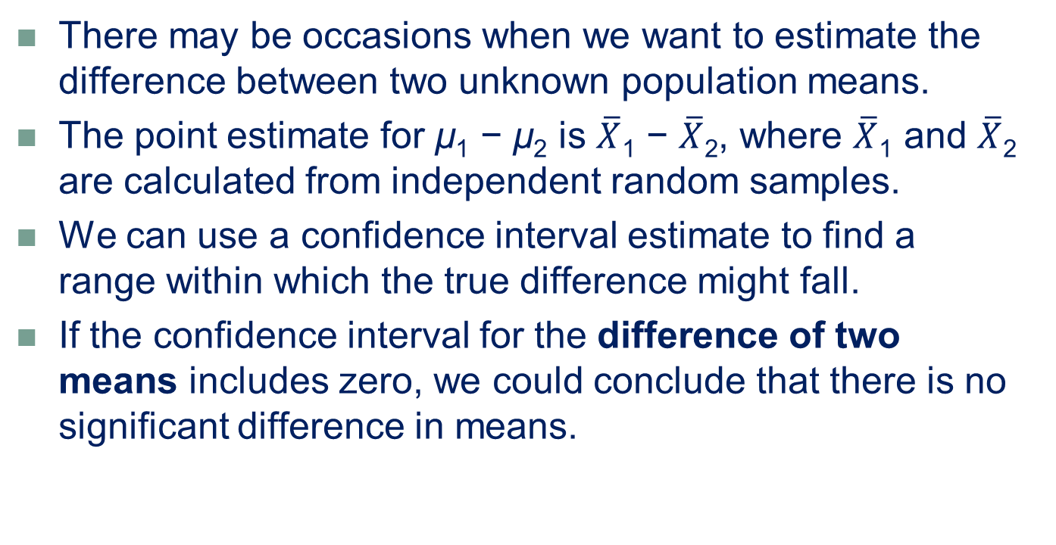
Confidence Interval for the Difference of Two Means
LO 10-3
There may be occasions when we want to estimate the difference between two unknown population means.
The point estimate for μ₁ − μ₂ is $\overline{X}$₁ − $\overline{X}$₂, where $\overline{X}$₁ and $\overline{X}$₂ are calculated from independent random samples.
We can use a confidence interval estimate to find a range within which the true difference might fall.
If the confidence interval for the difference of two means includes zero, we could conclude that there is no significant difference in means.

Slide 20
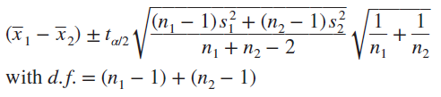
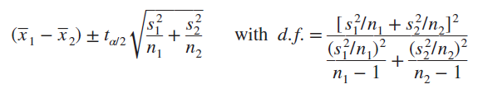
Confidence Interval for the Difference of Two Means
LO 10-3
When the population variances are unknown (the usual situation), the procedure for constructing a confidence interval for μ₁ − μ₂ depends on our assumption about the unknown variances.
Assuming Equal Variances
Assuming Unequal Variances

Slide 21
Example: Marketing Teams
LO 10-3
Do teams that collaborate virtually feel they get along better than teams that collaborate face-to-face?
A study was conducted with senior marketing majors at a large business school. Students were randomly assigned to a team that collaborated online or a team that collaborated face-to-face. Both teams were given five cases to analyze. At the end of the study, each team member was asked to rate how well he or she felt the team got along by responding to the statement “I felt our members got along well together.” The response scale was a 1–5 Likert scale with “1” = strongly disagree and “5” = strongly agree.

Slide 22
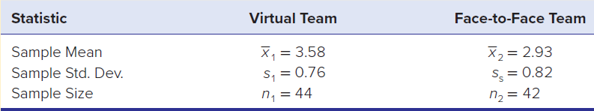
Example: Marketing Teams
LO 10-3
The table below shows the means and standard deviations of the two groups.
The population variances are unknown but will be assumed equal (note the similar standard deviations).
For a confidence level of 90 percent, we use Student’s t with d.f. = 44 + 42 − 2 = 84. From Appendix D we obtain t_{.05} = 1.664 (using 80 degrees of freedom, the next lower value).

Slide 23
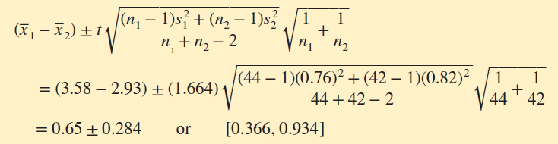
Example: Marketing Teams
LO 10-3
The confidence interval is:
Because this confidence interval does not include zero, we can say with 90 percent confidence that there is a difference between the means (i.e., the virtual team’s mean differs from the face-to-face team’s mean).

Slide 24
Paired Data
LO 10-4
When sample data consist of n matched pairs, a different approach is required. If the same individuals are observed twice but under different circumstances, we have a paired comparison.
For example:
Fifteen retirees with diagnosed hypertension are assigned a program of diet, exercise, and meditation. A baseline measurement of blood pressure is taken before the program begins and again after 2 months. Was the program effective in reducing blood pressure?
Ten cutting tools use lubricant A for 10 minutes. The blade temperatures are taken. When the machine has cooled, it is run with lubricant B for 10 minutes, and the blade temperatures are again measured. Which lubricant makes the blades run cooler?

Slide 25
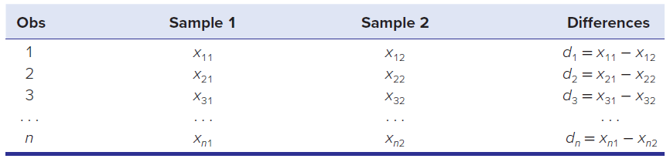
Paired t Test
LO 10-4
In the paired t test we define a new variable d = X₁ − X2 as the difference between X₁ and X₂. The two samples are reduced to one sample of n differences d₁, d₂, . . . , d_{n}.
We usually present the n observed differences in column form:

Slide 26
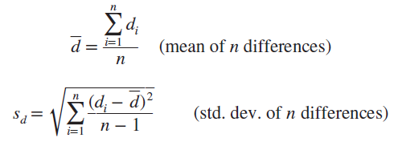

Paired t Test
LO 10-4
We calculate the mean $\overline{d}$ and standard deviation sd of the sample of n differences d₁, d₂, . . . , d_{n} with the usual formulas for a mean and standard deviation.
We call the mean $\overline{d}$ instead of $\overline{x}$ merely to remind ourselves that we are dealing with differences.

Slide 27


Paired t Test
LO 10-4
Because the population variance of d is unknown, we will do a paired t test using Student’s t with n − 1 degrees of freedom to compare the sample mean difference $\overline{d}$ with a hypothesized difference μ_{d} (usually μ_{d} = 0). The test statistic is really a one-sample t test,

Slide 28
Example: Repair Estimates
LO 10-4
An insurance company’s procedure in settling a claim under $10,000 for fire or water damage to a homeowner is to require two estimates for cleanup and repair of structural damage before allowing the insured to proceed with the work. The insurance company compares estimates from two contractors who most frequently handle this type of work in this geographical area. The table on the next slide shows the 10 most recent claims for which damage estimates were provided by both contractors.
At the .05 level of significance, is there a difference between the two contractors?

Slide 29

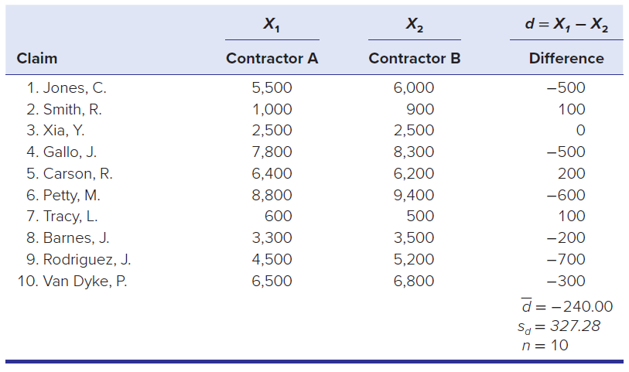
Example: Repair Estimates
LO 10-4
Step 1: State the Hypotheses
We will choose a two-tailed test using these hypotheses:

Slide 30

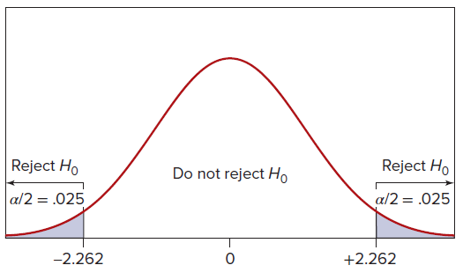
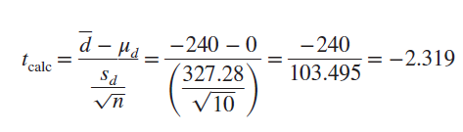
Example: Repair Estimates
LO 10-4
Step 2: Specify the Decision Rule
Our test statistic will follow a Student’s t distribution with d.f. = n − 1 = 10 − 1 = 9, so from Appendix D with α = .05 the two-tail critical value is t_{.025} = ± 2.262, as illustrated. The decision rule is
Step 3: Calculate the Test Statistic
The mean and standard deviation are calculated in the usual way, so the test statistic is

Slide 31
Example: Repair Estimates
LO 10-4
Step 4: Make the Decision
Because t_{calc} = −2.319 falls in the left-tail critical region (below −2.262), we reject the null hypothesis and conclude that there is a significant difference between the two contractors. However, it is a very close decision.
Step 5: Take Action
Because the difference is significant in a two-tailed test, it also would be significant in a left-tailed test. The insurance company might talk to Contractor B to see why its estimates are higher.

Slide 32

Paired Tests
LO 10-4
Analogy to a Confidence Interval
A two-tailed test for a zero difference is equivalent to asking whether the confidence interval for the true mean difference µ_{d} includes zero.
Why Not Treat Paired Data as Independent Samples?
When observations are matched pairs, the paired t test is more powerful because it utilizes information that is ignored if we treat the samples separately.

Slide 33
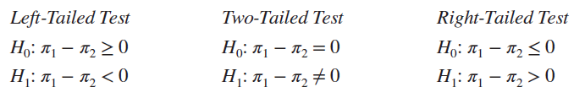
Comparing Two Proportions
LO 10-5
The test for two proportions is perhaps the most commonly used two-sample test because percents are ubiquitous.
Is the president’s approval rating greater than, less than, or the same as last month?
Is the proportion of satisfied Dell customers greater than HP’s?
Is the annual nursing turnover percentage at Mayo Clinic higher than, lower than, or the same as that at Johns Hopkins?
To compare two population proportions π₁ and π₂, use the following hypotheses:

Slide 34
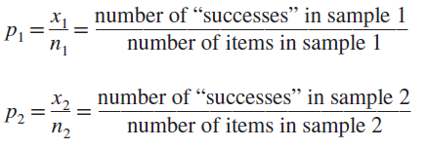
Comparing Two Proportions
LO 10-5
The sample proportion p₁ is a point estimate of π₁, and the sample proportion p₂ is a point estimate of π₂. A “success” is any event of interest (not necessarily something desirable).
If H₀ is true, there is no difference between π₁ and π₂, so the samples can logically be pooled into one “big” sample to estimate the combined population proportion p_{c}:

Slide 35
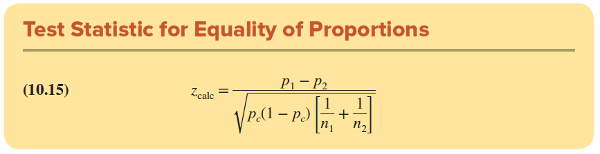
Test Statistic
LO 10-5
If the samples are large, p₁ – p₂ may be assumed normally distributed.
The test statistic is the difference of the sample proportions divided by the standard error of the difference.
The standard error is calculated by using the pooled proportion.
The test statistic for the hypothesis π₁ − π₂ = 0 is:

Slide 36
Example: Active Promoters
LO 10-5
In order to measure the level of satisfaction with Vail Resorts’ websites, the Vail Resorts marketing team periodically surveys a random sample of guests and asks them to rate their likelihood of recommending the website to a friend or colleague. An active promoter is a guest who responds that he or she is highly likely to recommend the website. From a random sample of 2,386 Vail ski mountain guests in last year’s ski season, there were 2,014 active promoters and from a random sample of 2,309 Vail ski mountain guests in this year’s ski season, there were 2,048 active promoters. Results from the survey are shown in the table on the next slide.
At the .01 level of significance, did the proportion of active promoters increase?

Slide 37
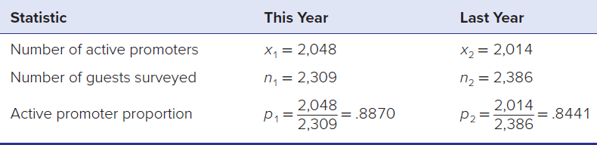

Example: Active Promoters
LO 10-5
Step 1: State the Hypotheses
Because Vail Resorts had redesigned its ski mountain websites for this year’s season, it was interested in seeing if the proportion of active promoters had increased. Therefore, we will do a right-tailed test for equality of proportions.

Slide 38

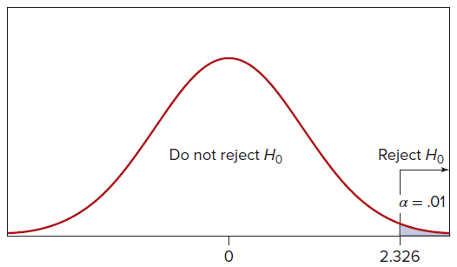
Example: Active Promoters
LO 10-5
Step 2: Specify the Decision Rule
Using α = .01, the right-tail critical value is z_{.01} = 2.326, which yields the decision rule

Slide 39

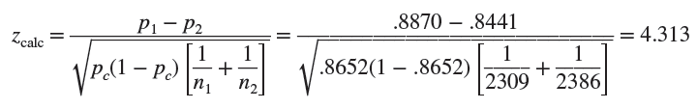
Example: Active Promoters
LO 10-5
Step 3: Calculate the Test Statistic
Assuming that the proportions are equal, we can pool the two samples to obtain a pooled estimate of the common proportion by dividing the combined number of active promoters by the combined sample size.
Assuming normality (i.e., large samples), the test statistic is

Slide 40
Example: Active Promoters
LO 10-5
Step 4: Make the Decision
If H₀ were true, the test statistic should be near zero. Because the test statistic (z_{calc} = 4.313) exceeds the critical value (z_{.01} = 2.326), we reject the null hypothesis and conclude that π₁ − π₂ > 0.
Step 5: Take Action
Keep the new website design because it appears to increase the number of promoters.
Test Statistic: Z = 4.313
Reject H₀

Slide 41
Checking Normality
LO 10-6
We have assumed a normal distribution for the statistic p₁ – p₂.
This assumption can be checked.
For a test of two proportions, the criterion for normality is nπ ≥ 10 and n(1 − π) ≥ 10 for each sample, using each sample proportion in place of π.
If either sample proportion is not normal, their difference cannot safely be assumed normal.
The sample size rule of thumb is equivalent to requiring that each sample contains at least 10 “successes” and at least 10 “failures.”

Slide 42
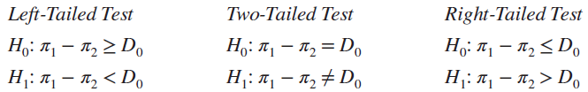
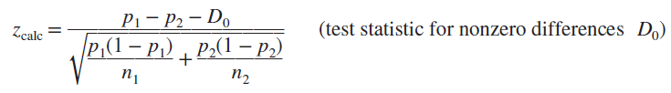
Testing for Non-Zero Difference
LO 10-6
Testing for equality of π₁ and π₂ is a special case of testing for a specified difference D0 between the two proportions:
We have shown how to test for D₀ = 0, that is, π₁ = π₂. If the hypothesized difference D₀ is nonzero, we do not pool the sample proportions but instead use the test statistic shown

Slide 43

Confidence Interval for the Difference of Two Proportions
LO 10-7
A confidence interval for the difference of two population proportions, π₁ − π₂, is given by
This formula assumes that both samples are large enough to assume normality. The rule of thumb for assuming normality is that np ≥ 10 and n(1 − p) ≥ 10 for each sample.

Slide 44
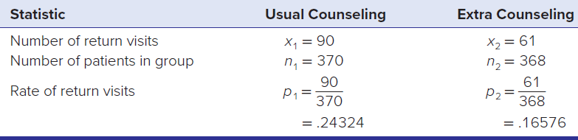
Example: Hospital Cost
LO 10-7
Hospital emergency department visits are a major contributor to health care costs. Moreover, such visits often are followed by another visit soon after discharge.
Researchers wanted to know if extra counseling of emergency patients prior to discharge would reduce the likelihood of a return emergency visit within 30 days.
Following treatment, randomly selected emergency patients were divided into two groups in a double-blind experiment. The first group received normal counseling prior to discharge, while the second group received extra counseling, education, and follow-up phone calls. The results are shown.

Slide 45
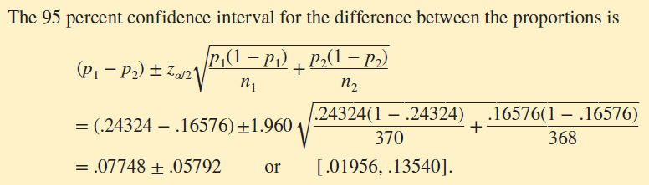
Example: Hospital Cost
LO 10-7
Because the confidence interval [.01956, .13540] does not include zero, there is a significant difference in the rate of return visits. This suggests that extra counseling would be helpful in terms of patient safety and also might reduce cost as long as the per-patient cost of extra counseling is less than the cost of a return emergency visit.

Slide 46
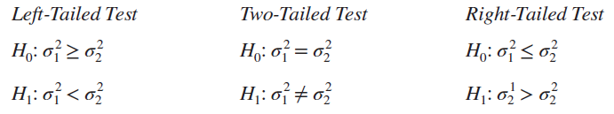
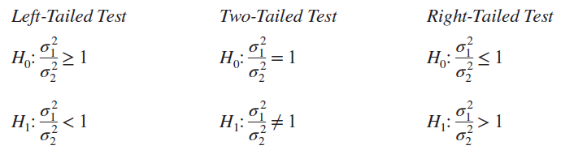
Comparing Two Variances
LO 10-8
Comparing the variances may be as important as comparing the means of two populations.
We may test the null hypothesis against a left-tailed, two-tailed, or right-tailed alternative:
An equivalent way to state these hypotheses is to look at the ratio of the two variances. A ratio near 1 would indicate equal variances.

Slide 47
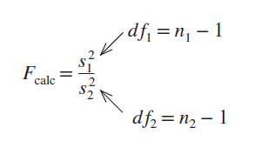
The F Test
LO 10-8
The test statistic is the ratio of the sample variances.
Assuming the populations are normal, the test statistic follows the F distribution
If the null hypothesis of equal variances is true, this ratio should be near 1

Slide 48
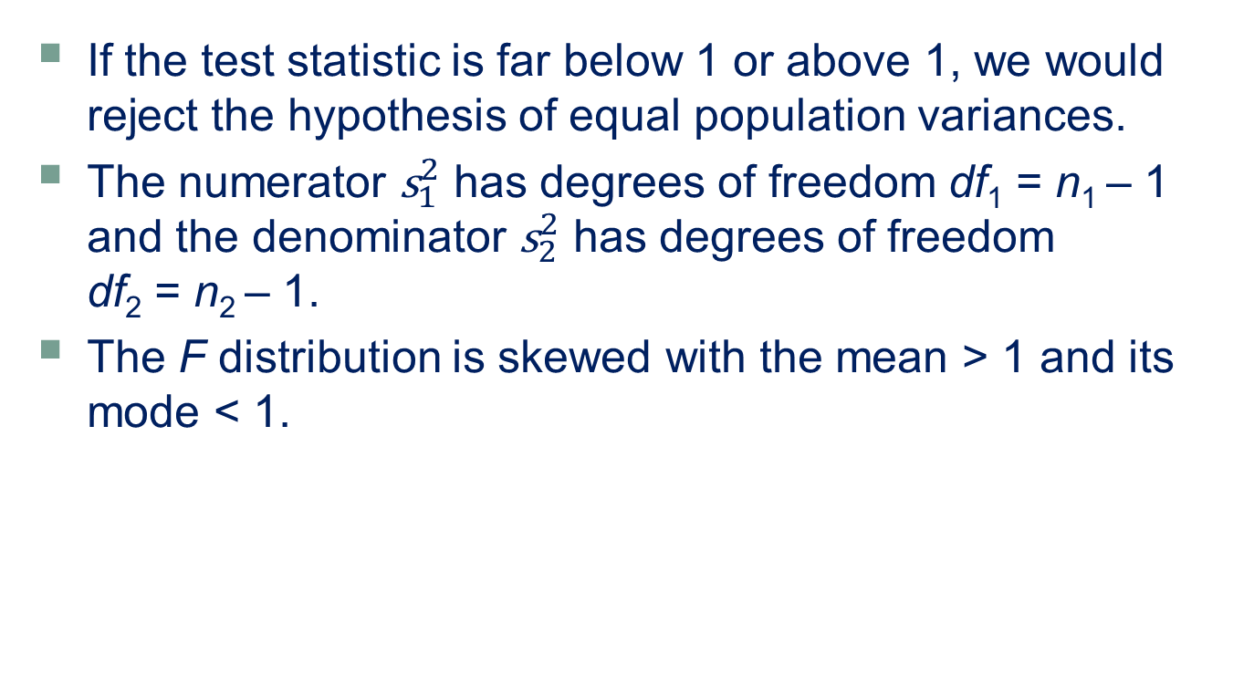
The F Test
LO 10-8
If the test statistic is far below 1 or above 1, we would reject the hypothesis of equal population variances.
The numerator ${\text{s}}_{1}^{2}$ has degrees of freedom df₁ = n₁ – 1 and the denominator ${\text{s}}_{2}^{2}$ has degrees of freedom df₂ = n₂ – 1.
The F distribution is skewed with the mean > 1 and its mode < 1.

Slide 49
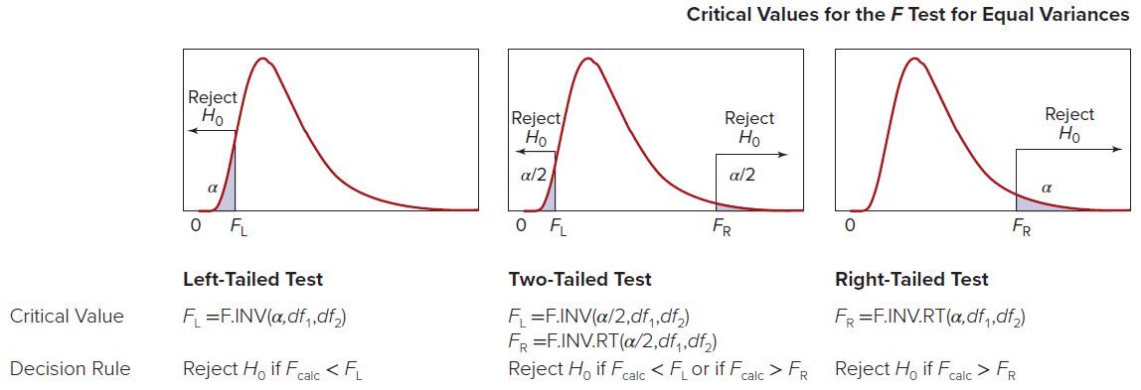
Critical Values for the F Test
LO 10-8
Critical values for the F test are denoted F_{L} (left tail) and F_{R} (right tail).
A right-tail critical value F_{R} may be found from Appendix F using df₁ and df₂ degrees of freedom. F_{R} = F_{df1, df2}
A left-tail critical value F_{R} may be found by reversing the numerator and denominator degrees of freedom, finding the critical value from Appendix F and taking its reciprocal: F_{L} = 1/F_{df2, df1}

Slide 50
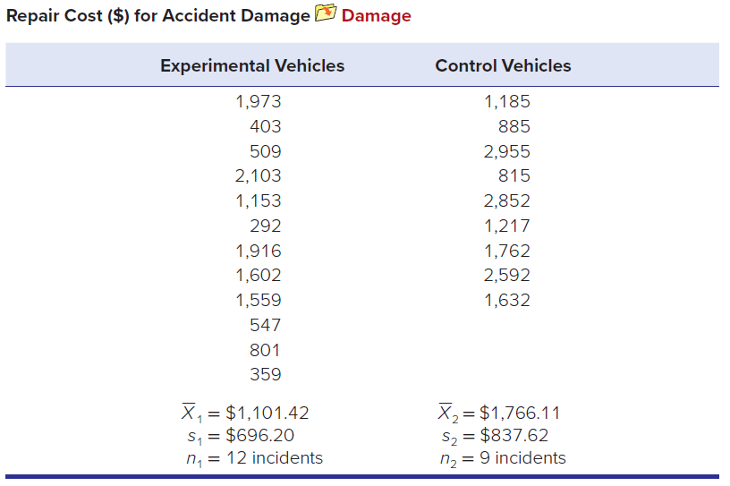
Example: Collision Damage
LO 10-8
An experimental bumper was designed to reduce damage in low-speed collisions. This bumper was installed on an experimental group of vans in a large fleet, but not on a control group. At the end of a trial period, accident data showed 12 repair incidents (a “repair incident” is a repair invoice) for the experimental vehicles and 9 repair incidents for the control group vehicles.

Slide 51
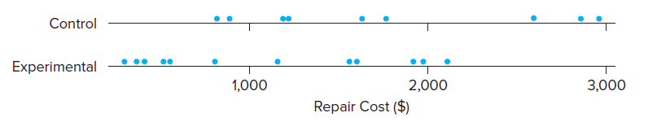

Example: Collision Damage
LO 10-8
A dot plot of the two samples suggests that the new bumper may have reduced the mean damage. However, the firm was also interested in whether the variance in damage had changed. We use the F test to test the hypothesis of equal variances. Do the sample variances support the idea of equal variances in the population? We will perform a two-tailed test.
Step 1: State the Hypotheses
For a two-tailed test for equality of variances, the hypotheses are

Slide 52

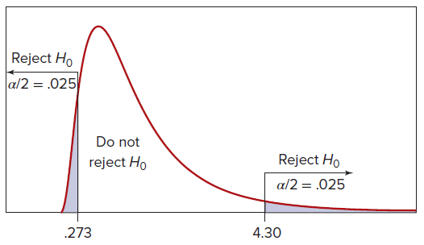

Example: Collision Damage
LO 10-8
Step 2: Specify the Decision Rule
Degrees of freedom for the F test are
For a two-tailed test, we split the α risk and put α/2 in each tail. Using Excel, the left-tail critical value for α/2 = .025 is F_{L} =F.INV(.025,11,8) = 0.273, and the right-tail critical value is F_{R} =F.INV(.975,11,8) = 4.243.

Slide 53

Example: Collision Damage
LO 10-8
Step 3: Calculate the Test Statistic
The test statistic is
Step 4: Make a Decision
Because F_{calc} = 0.691, we cannot reject the hypothesis of equal variances in a two-tailed test at α = .05. In other words, the ratio of the sample variances does not differ significantly from 1.

Slide 54

Folded F Test
LO 10-8
We can make the two-tailed test for equal variances into a right-tailed test, so it is easier to look up the critical values in Appendix F. This method requires that we put the larger observed variance in the numerator, and then look up the critical value for α/2 instead of the chosen α.
The test statistic for the folded F test is

Slide 55
Chapter 10 Practice Problems

Slide 56
Question 5
LO 10-2
When the background music tempo was slow, the mean amount of bar purchases for a sample of 17 restaurant patrons was $30.47 with a standard deviation of $15.10. When the background music tempo was fast, the mean amount of bar purchases for a sample of 14 patrons in the same restaurant was $21.62 with a standard deviation of $9.50.
a. Assuming equal variances, at α = .01, is the true mean higher when the music is slow?
b. Calculate the p-value using Excel.

Slide 57
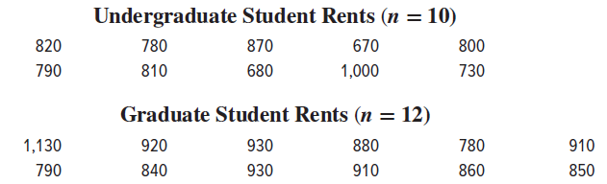
Question 12
LO 10-3
Construct a 95 percent confidence interval for the difference of mean monthly rent paid by undergraduates and graduate students. What do you conclude?

Slide 58
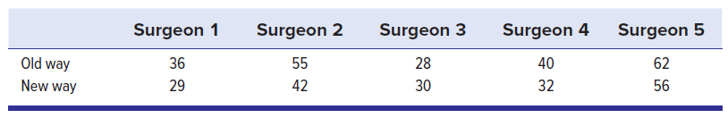
Question 14
LO 10-4
An experimental surgical procedure is being studied as an alternative to the old method. Both methods are considered safe. Five surgeons perform the operation on two patients matched by age, sex, and other relevant factors, with the results shown. The time to complete the surgery (in minutes) is recorded.
a. At the 5 percent significance level, is the new way faster? State your hypotheses and show all steps clearly.
b. Is the decision close?

Slide 59
Question 24
LO 10-5
During the period 1990–1998 there were 46 Atlantic hurricanes, of which 19 struck the United States. During the period 1999–2006 there were 70 hurricanes, of which 45 struck the United States.
a. State the hypotheses to test whether the percentage of hurricanes that strike the United States is increasing.
b. Calculate the test statistic.
c. State the critical value at α = .01.
d. What is your conclusion?
e. Can normality of p1 − p2 be assumed?

Slide 60
Question 33
LO 10-7
The American Bankers Association reported that in a sample of 120 consumer purchases in France, 60 were made with cash, compared with 26 in a sample of 50 consumer purchases in the United States. Construct a 90 percent confidence interval for the difference in proportions.

Slide 61
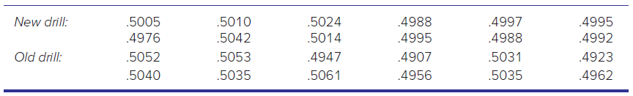
Question 39
LO 10-8
A manufacturing process drills holes in sheet metal that are supposed to be 0.5000 cm in diameter. Before and after a new drill press is installed, the hole diameter is carefully measured (in cm) for 12 randomly chosen parts. At α = .05, do these independent random samples prove that the new process has smaller variance? Show the hypotheses, decision rule, and test statistic. Hint: Use Excel =F.INV(α,n₁−1, n₂−1) to get F_{L}.

Slide 62
Chapter 10 Analytics in Action

Slide 63
